Slide 1
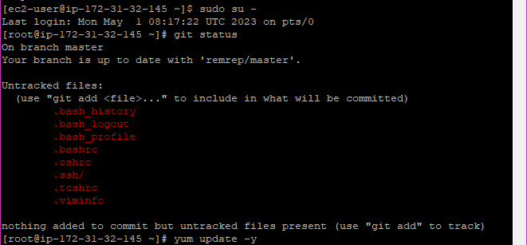
Git is already installed

Slide 2
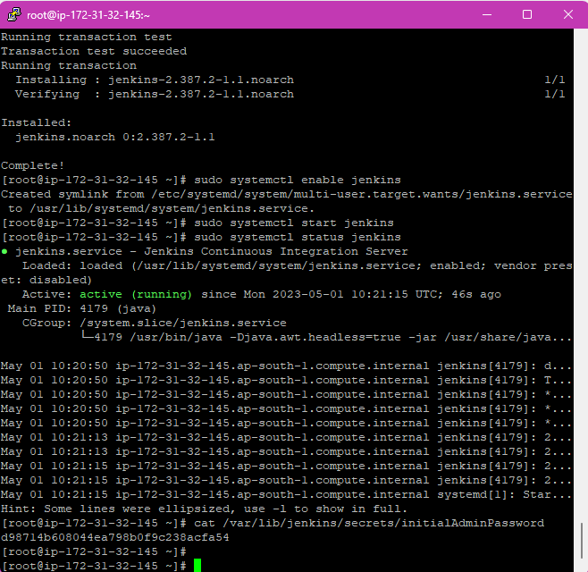
Installed Jenkins in the 1st instance and it’s status is active

Slide 3
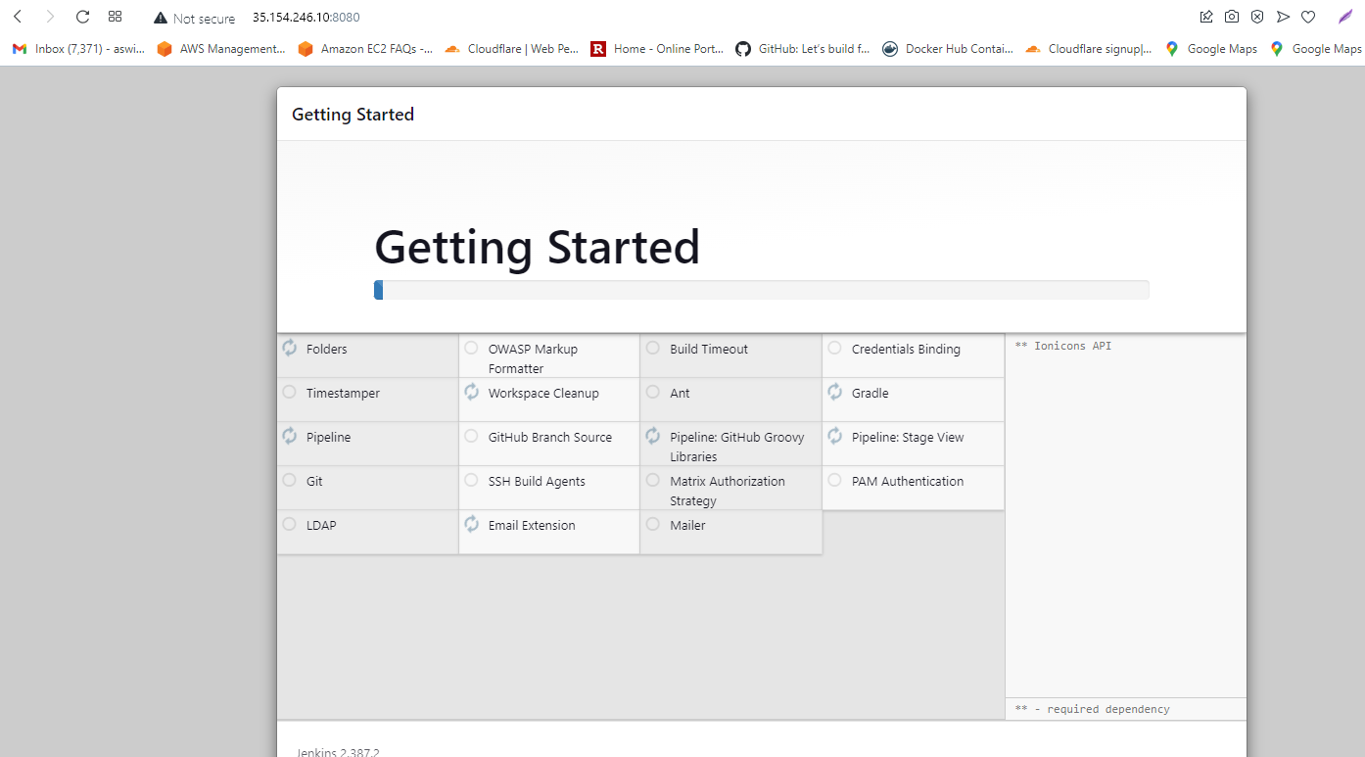
Installed Jenkins with its suggested plugins

Slide 4
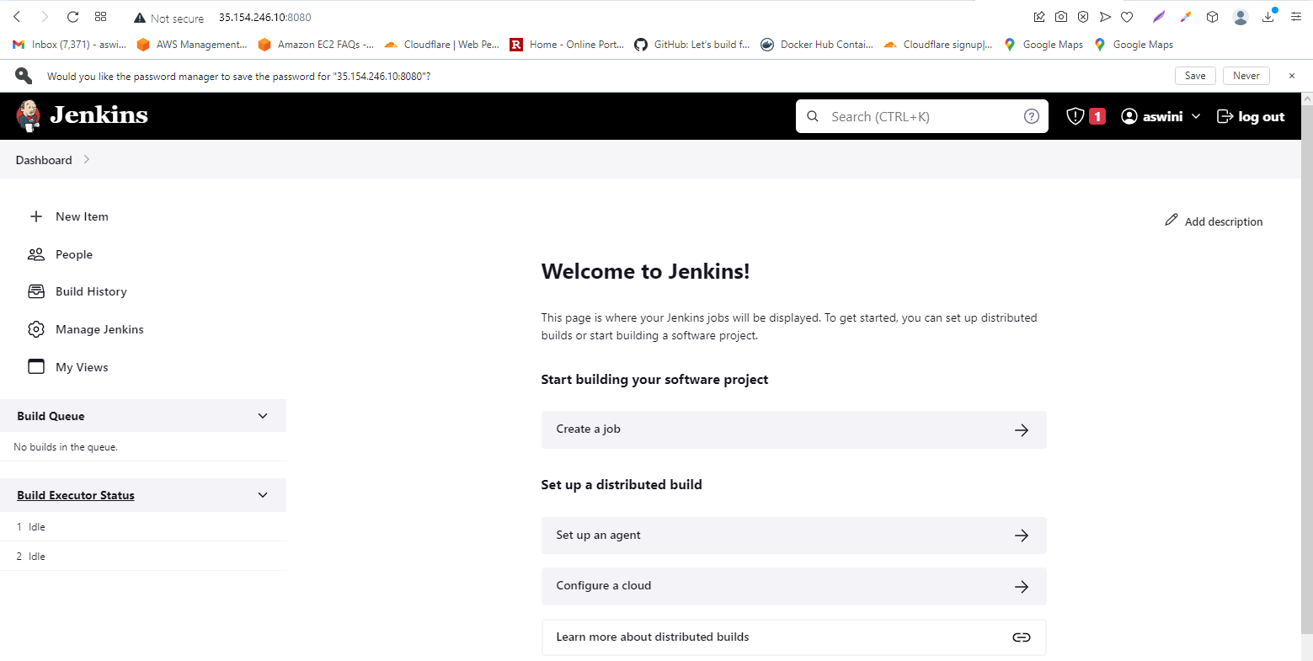
Jenkins dashboard is ready

Slide 5
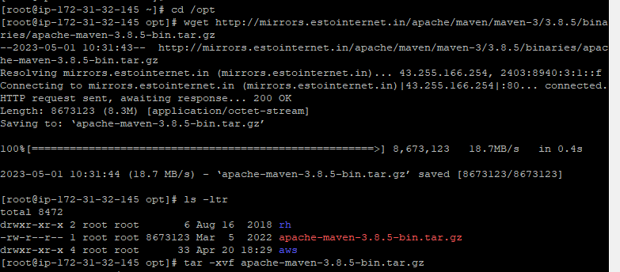
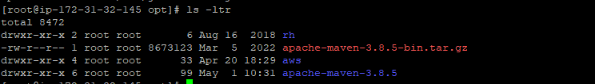
Maven is installed and unzipped

Slide 6
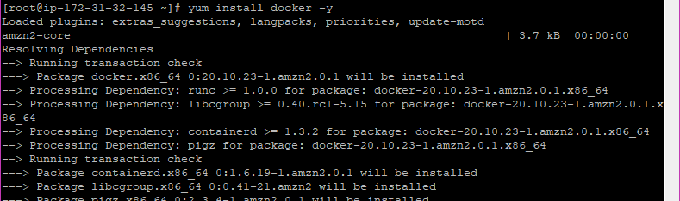
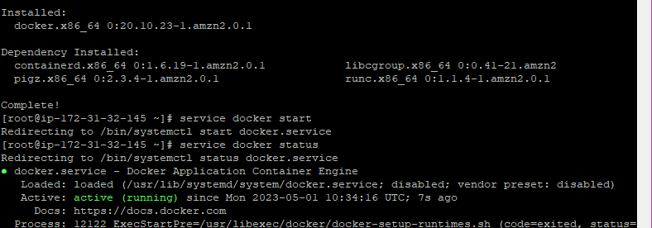
Installed Docker for containerization and it is active now

Slide 7
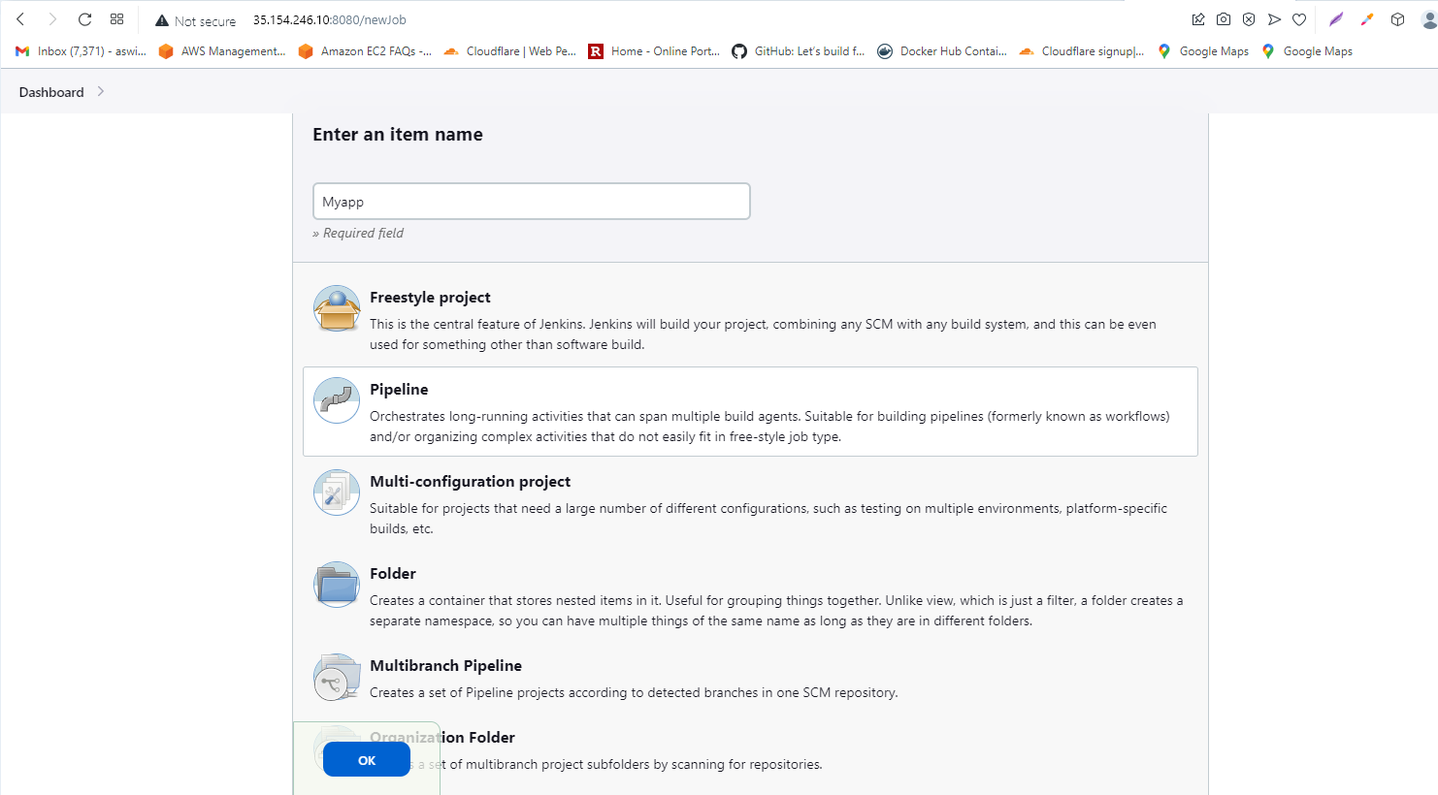
Creating a job as a pipeline in Jenkins

Slide 8
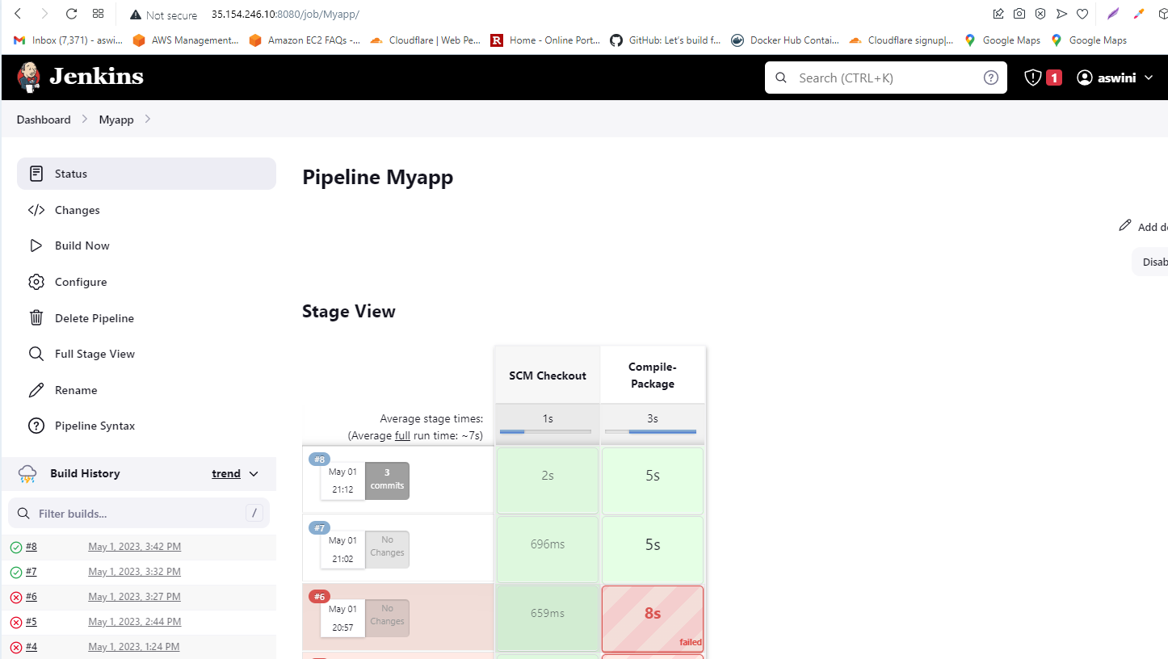
Maven is working now, it compiled the files

Slide 9
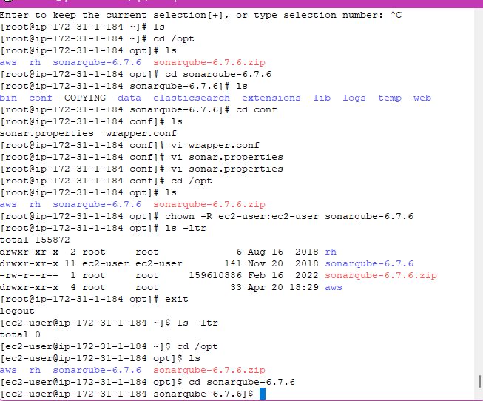
Installed Sonarqube and made changes in the 2 conf file
Sonarqube should not be started as a root user, so changed the ownership to default user

Slide 10
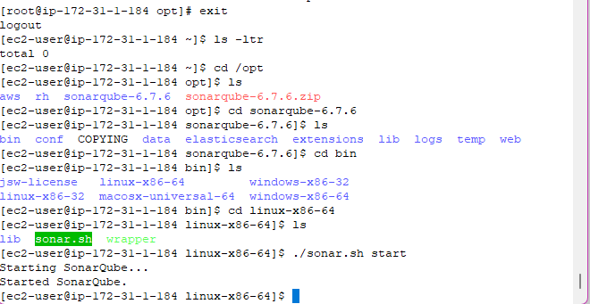
Sonarqube is started

Slide 11
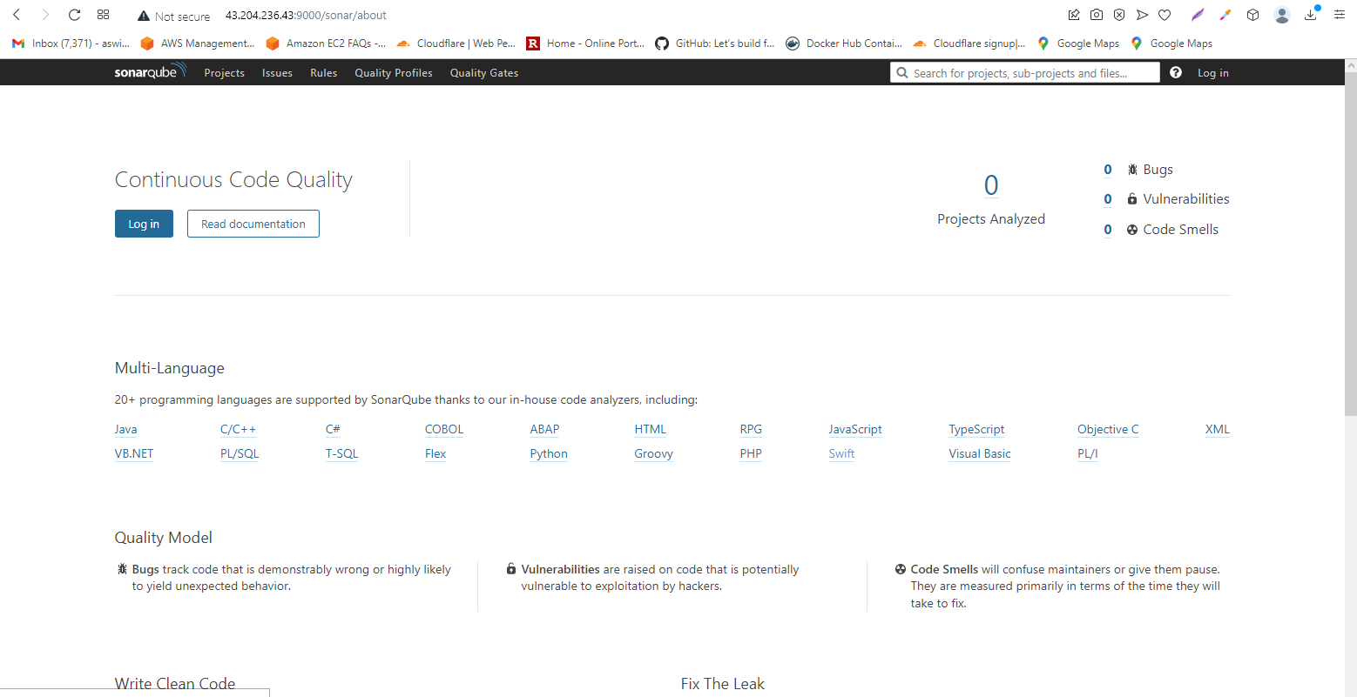
Sonarqube’s dashboard in browser

Slide 12
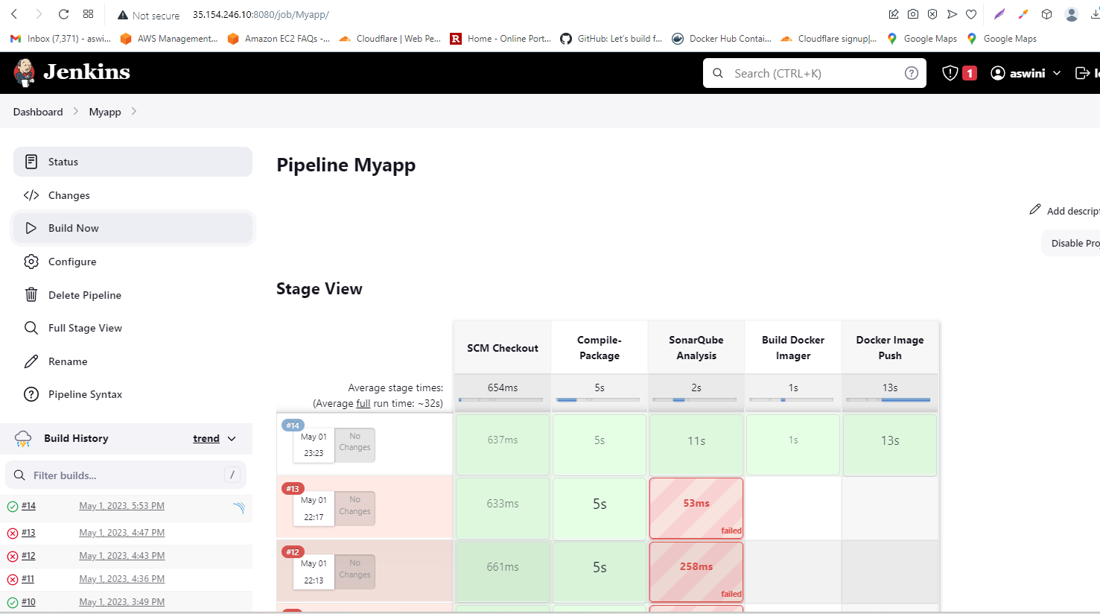
Added Sonarqube part of code in Jenkins and the build was successfull

Slide 13
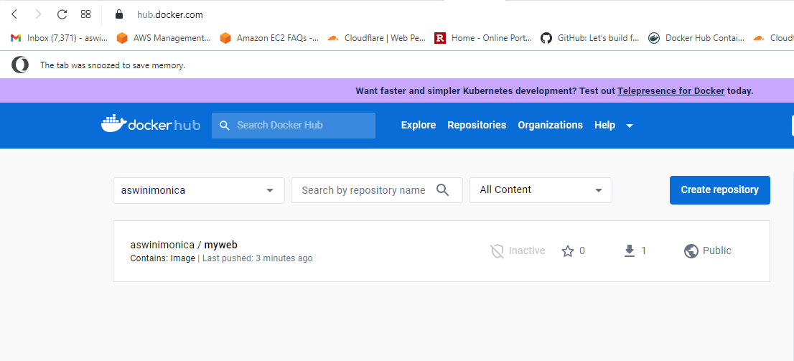
Code got pushed to Dockerhub

Slide 14
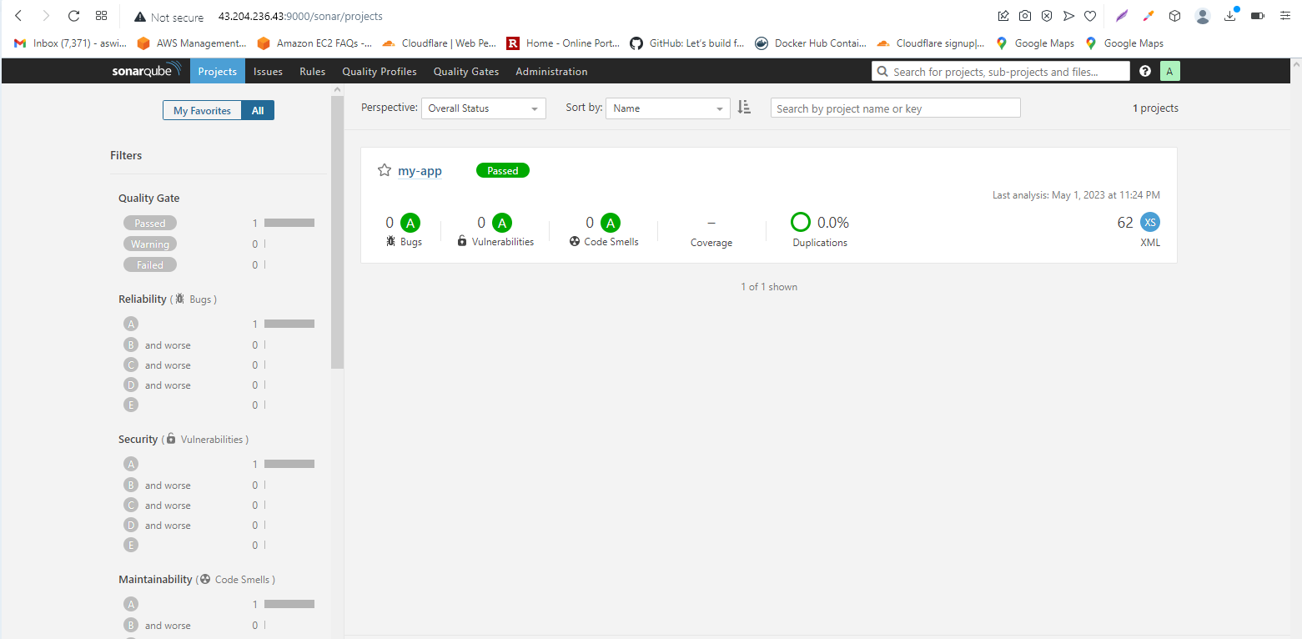
Sonarqube’s dashboard was updated with the quality check results of my application code

Slide 15
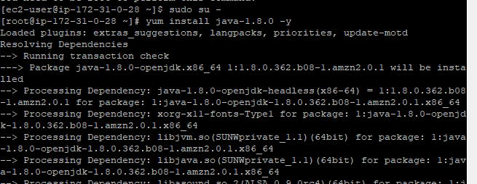
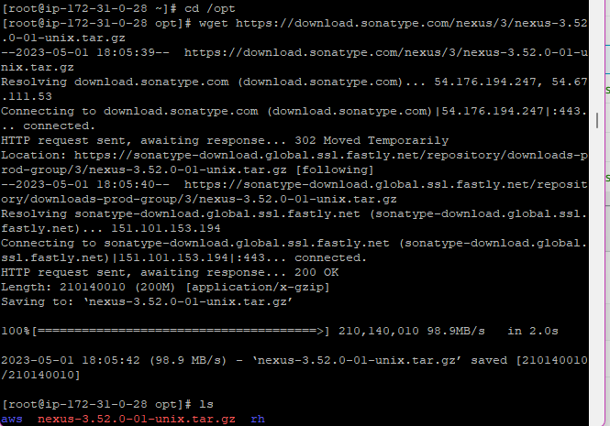
Have to install Nexus in another instance with Java

Slide 16
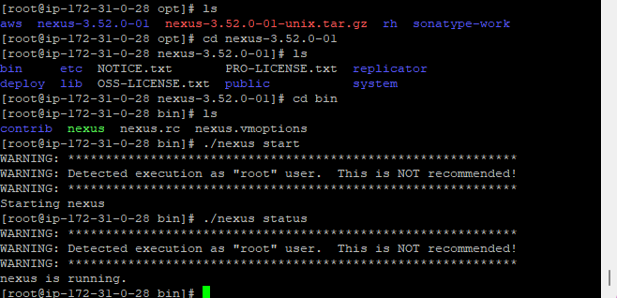
Nexus is started and running

Slide 17
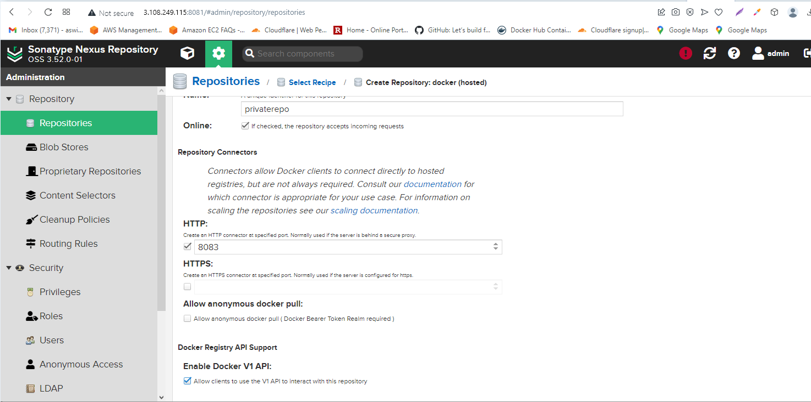
Creating a private docker (hosted) repo in nexus

Slide 18
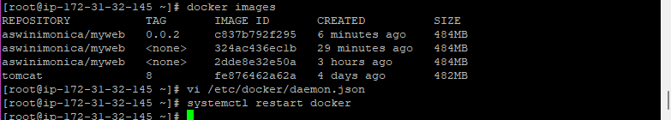
Created daemon.json file in Jenkins machine for docker and restarted the docker

Slide 19
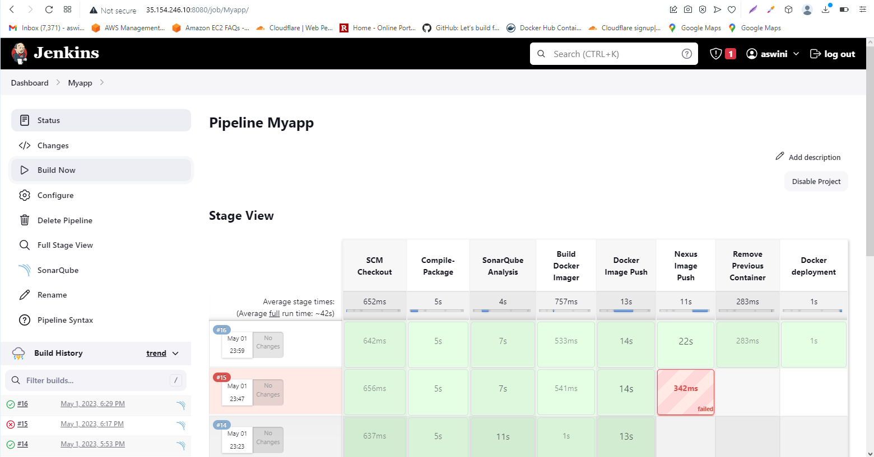
Whole pipeline was successfull

Slide 20
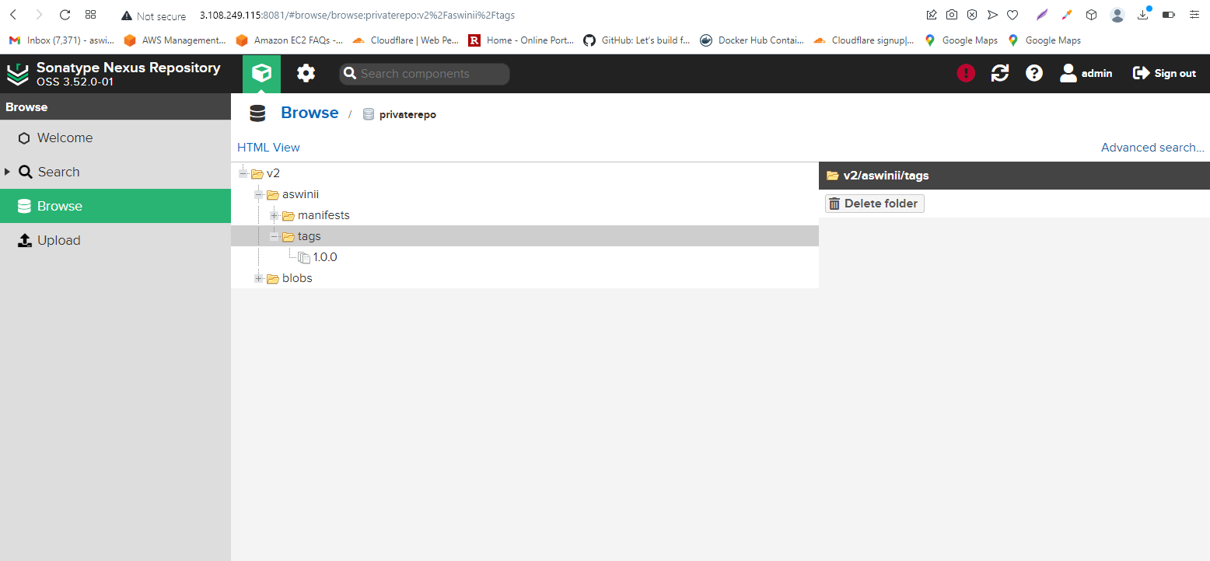
Our code got pushed to Nexus (private repo) as a final step

Slide 21
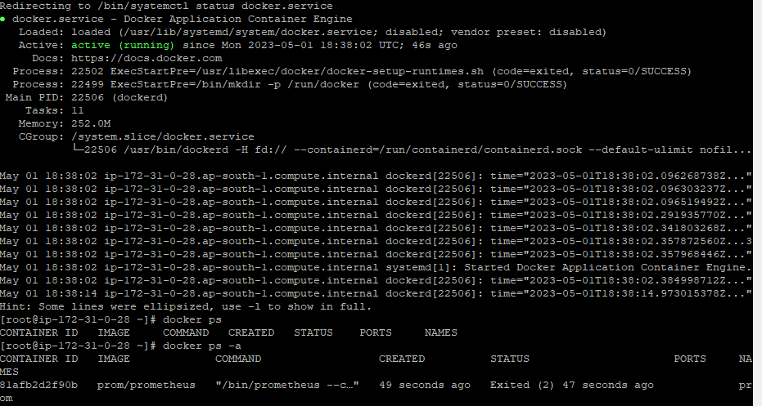
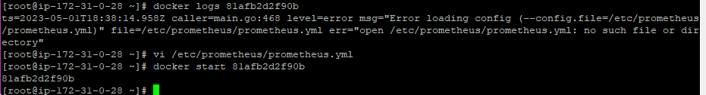
Running Prometheus in 3rd machine as a docker container

Slide 22
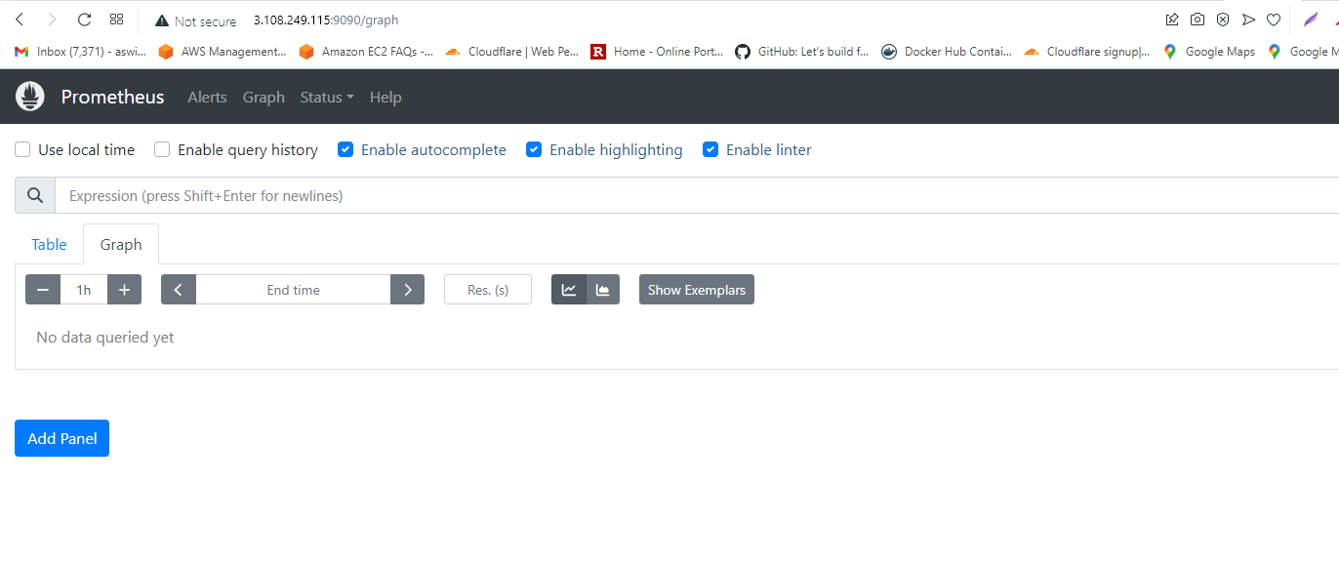
Prometheus is running in :9090 port number

Slide 23
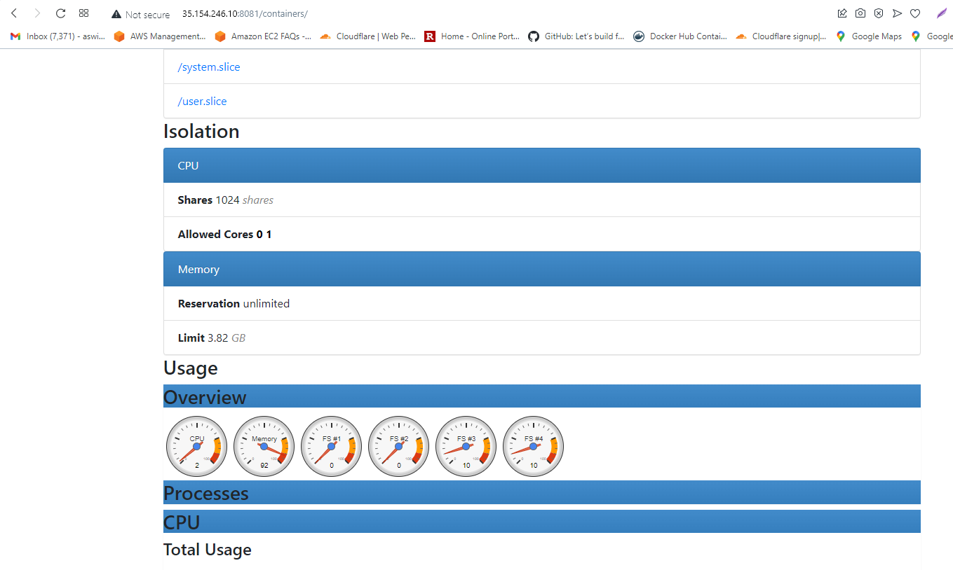
Running Cadvisor in 1st machine as a docker container in :8081 port for checking usage and performance

Slide 24
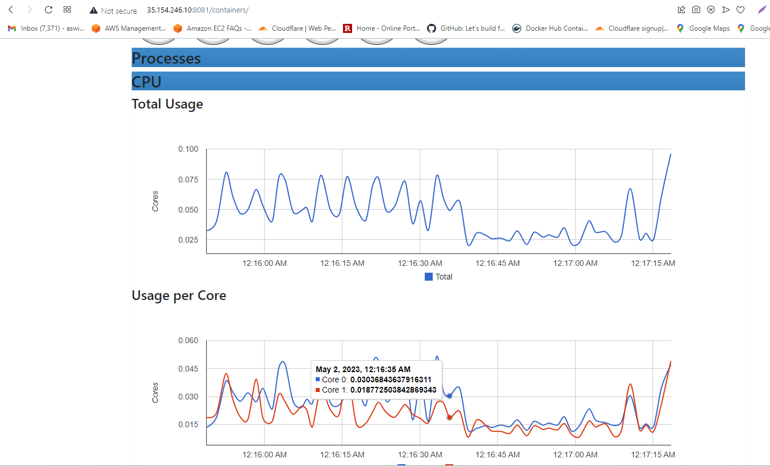

Slide 25
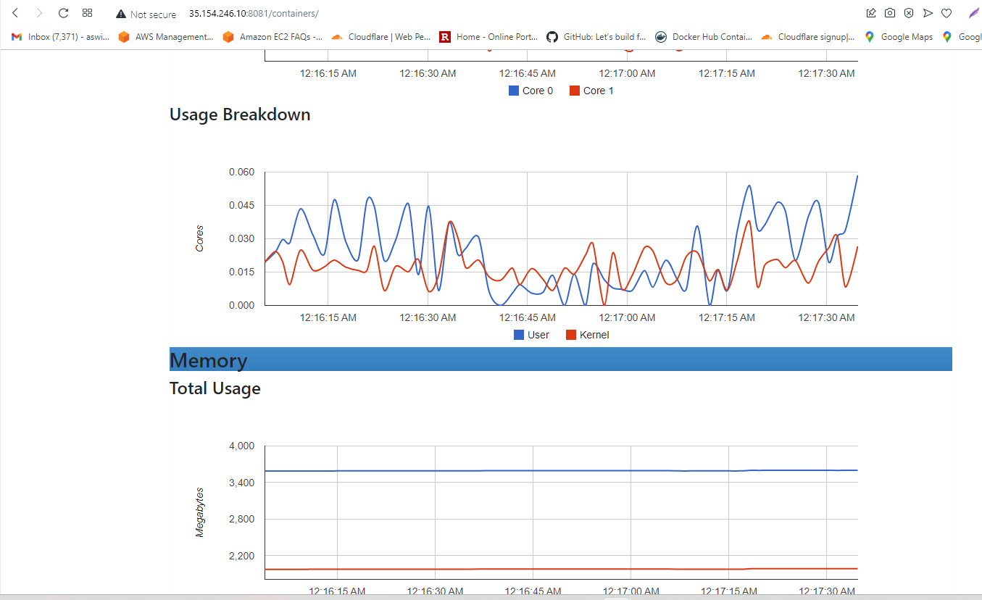

Slide 26
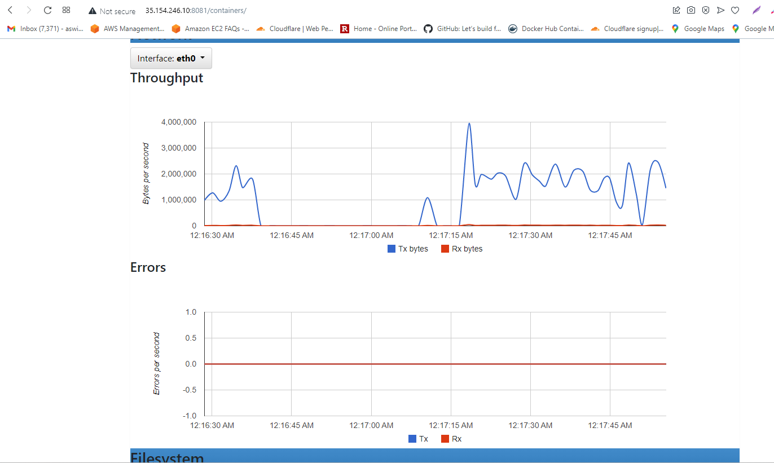

Slide 27
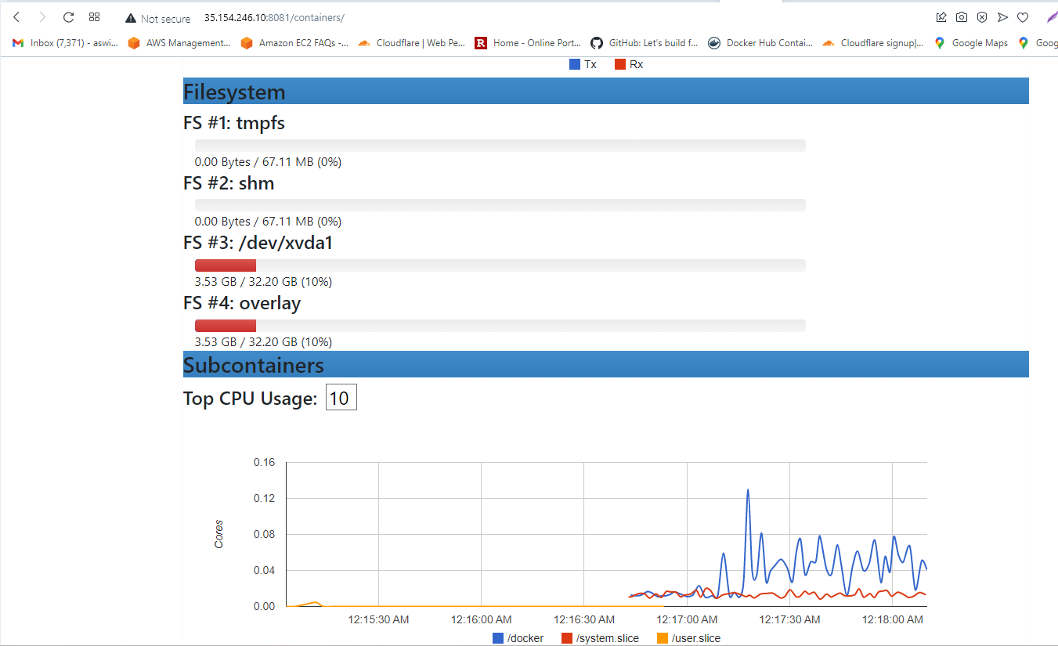

Slide 28
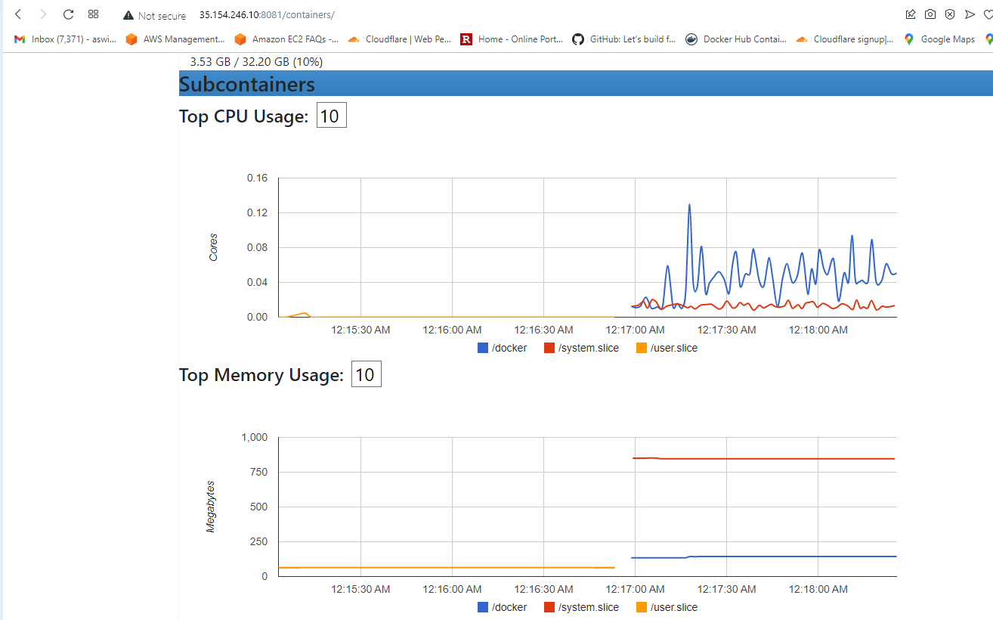

Slide 29
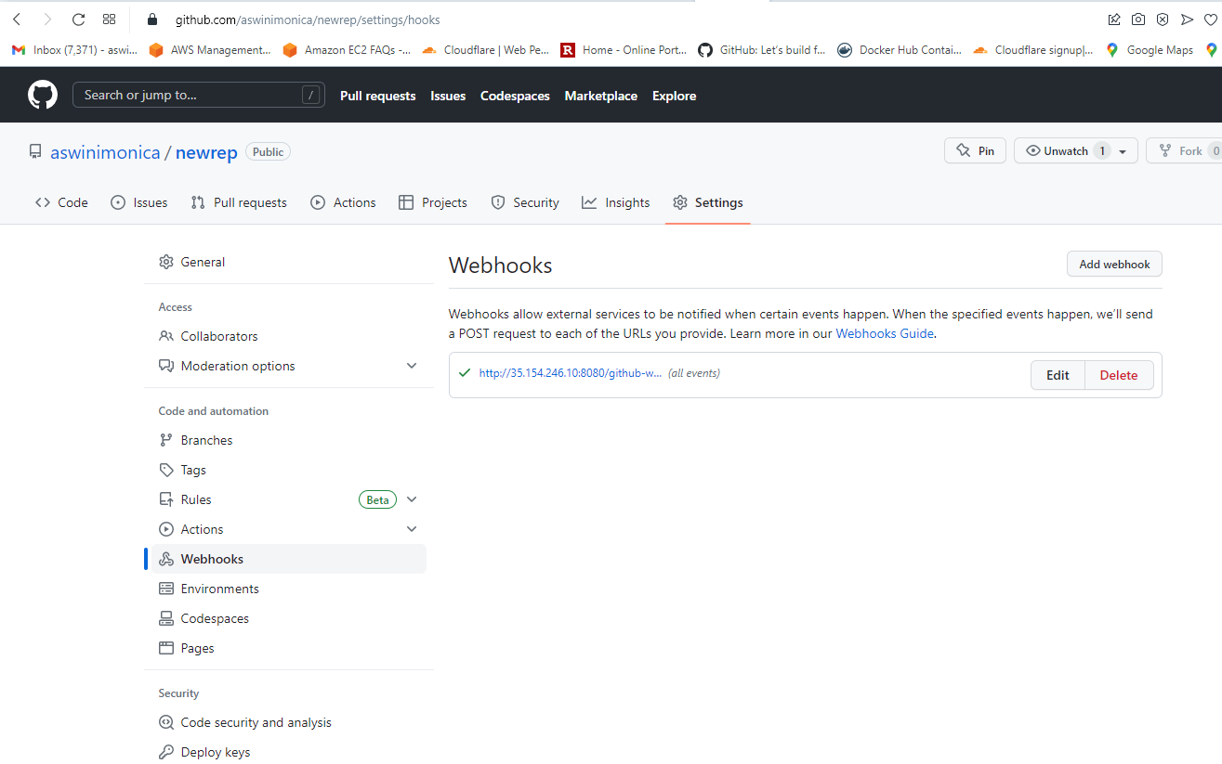
We are using Webhooking mechanism to integrate Jenkins with Github

Slide 30
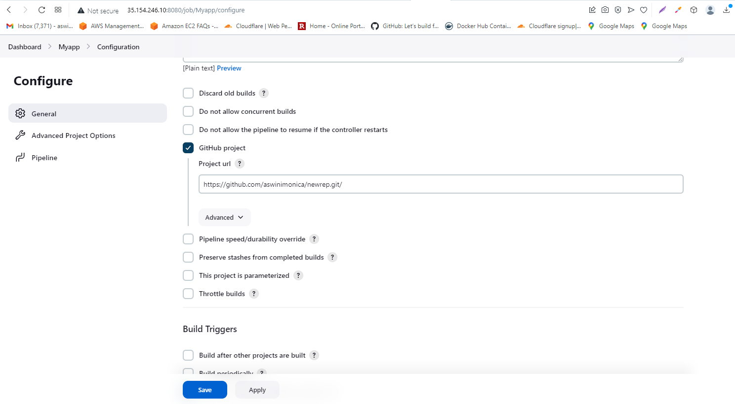

Slide 31
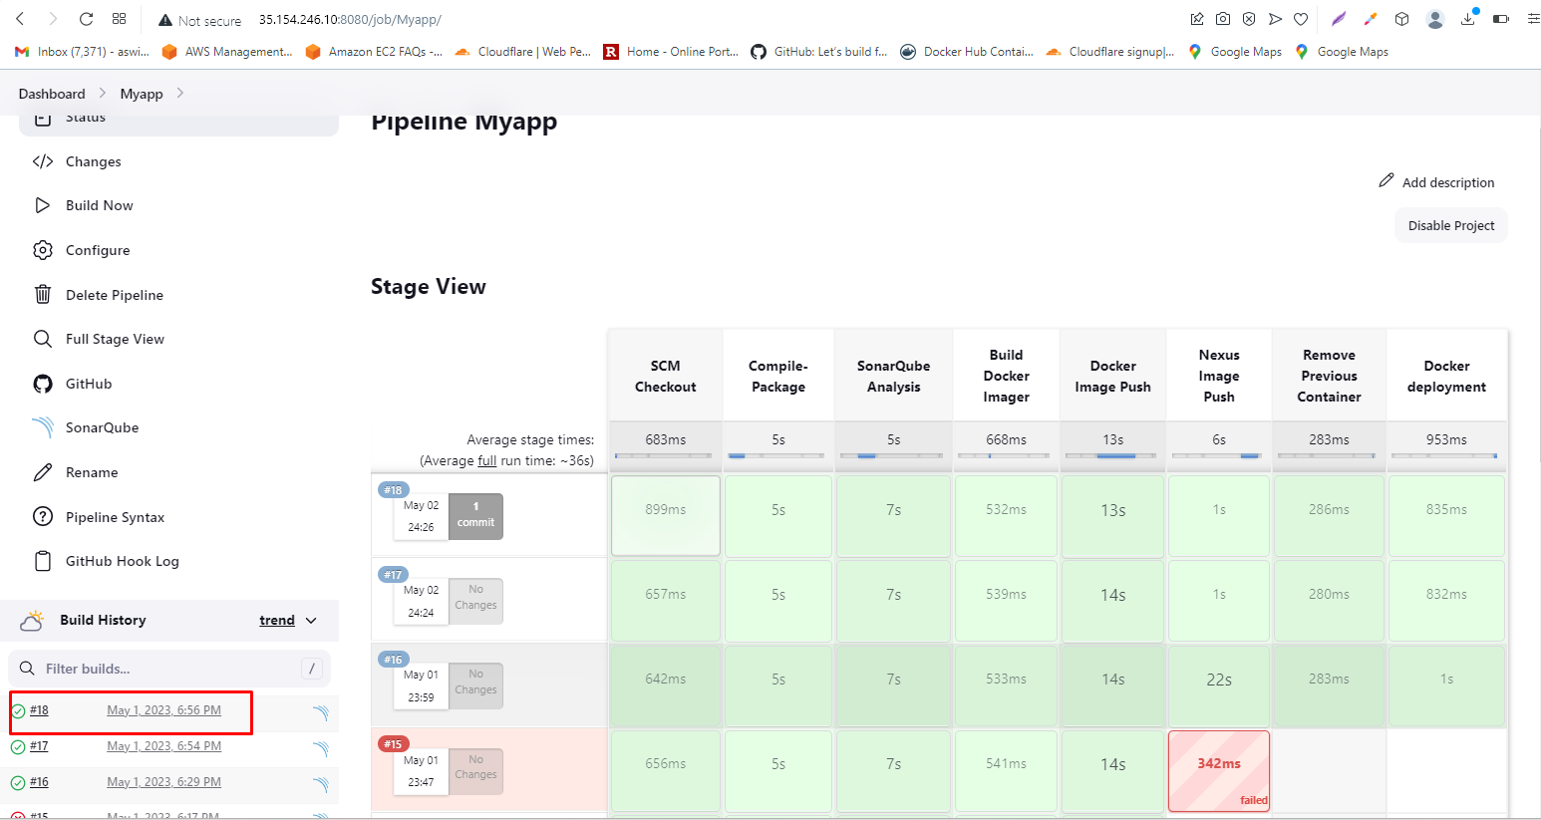
Job Build #18 is my last manual build before webhook

Slide 32
Commit in Github trigger the job build in Jenkins using Webhook
(uploaded the video of work flow separately)

Slide 33
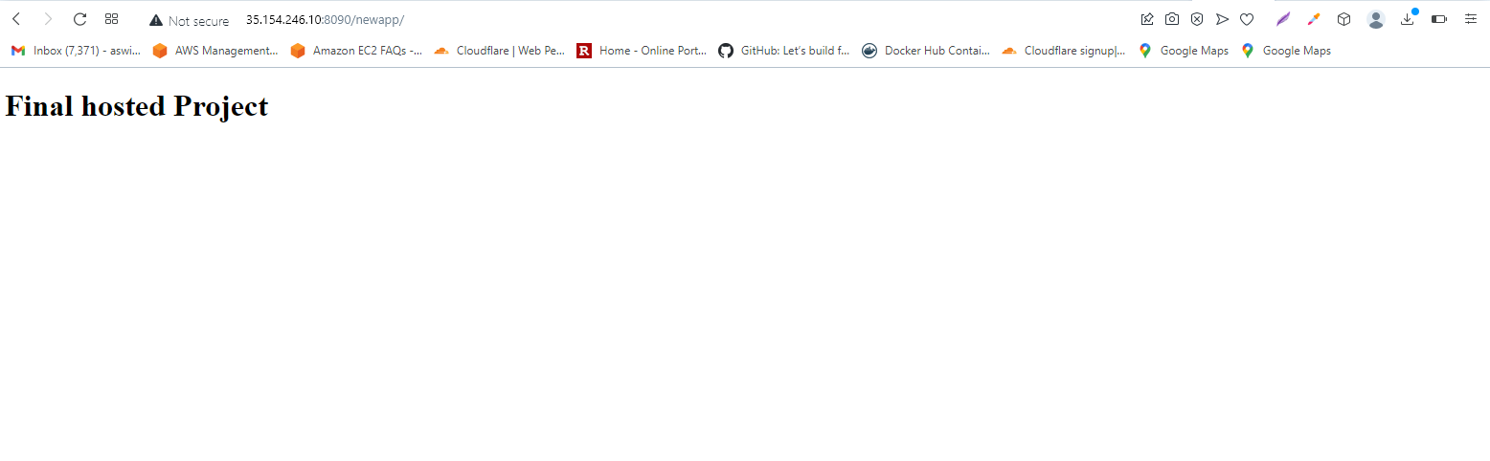
Our final Application code’s output

